Slide 1
Celebrating 40 years
Arkansas’s premier leadership development program

Slide 2
What is LeadAR?
LeadAR is a program designed to help Arkansans broaden their understanding of issues and opportunities facing our state and strengthen their ability to make a difference.

Slide 3
How does LeadAR work?
The LeadAR model employs an interdisciplinary approach to leadership development by championing the intersection of theory, practice, and application.
While exploring the major issues facing Arkansas communities is key to achieving lasting change, LeadAR recognizes that that is not enough. Subject matter experts, leadership theory, communication techniques, experiential leaning opportunities, and critical thinking exercises equip participants with the tools necessary to catalyze change using strategies that are equitable, empowering, and sustainable.

Slide 4
Why join LeadAR?
LeadAR is for Arkansans from rural and urban parts of our state who want to:
Assume greater leadership responsibilities
Understand complex cultural, social and economic issues impacting us today, and in the future
Improve their ability to interact and work with others
Deepen their understanding of social, economic and political systems in order to effectively bring about change
Develop critical thinking and decision-making skills to become a better citizen and leader
Connect to people and resources that can help them make a difference

Slide 5
What is involved in being a LeadAR participant?
LeadAR is an 18-month intensive hands-on program. If selected, you will participate in:
One three-day team building and goal setting seminar at the C.A. Vines Arkansas 4-H Center in Little Rock.
Six two-day seminars located around the state, including tours, guest speakers, and interactive activities
Video-conference sessions and other activities between seminars for supplemental learning
National study tour to Washington, D.C. to learn about issues and policy making from a national perspective
International study tour to learn how international issues and policy impact the U.S. and Arkansas, explore innovations and different approaches used in other countries that we can learn from, and see the world from a different perspective.
Leadership Service Project to make a positive difference.

Slide 6
National Study Tour
In year one you will travel to Washington D.C. where you will explore the complexities of policy development alongside law makers and policy experts.
Additionally, you will meet with top-level officials representing government agencies, nonprofits, and industry. You will also meet with your congressional delegation and their top aides to discuss current issues facing your own communities and how they can be addressed.

Slide 7
International Study Tour
In year two you will have the opportunity to travel to a different country for seven to ten days. This study tour offers the opportunity to meet with a broad array of leaders including ambassadors, farmers, government ministers, corporate executives, nonprofit leaders, and other stakeholders. Through this hands-on approach, participants will explore different global issues and political dynamics—issues such as politics, economics, trade, commerce, education, culture and agriculture—and compare them to the United States.
Since the program began, LeadAR class members have visited 34 countries. The country selected for the international study tour is determined by the LeadAR Advisory Council with approval by the UA System Division of Agriculture’s Associate Vice President for Agriculture–Extension. Travel locations are selected based on current events, learning opportunities, and in-country resources that support the program’s educational objectives and safety of the participants.
Note: If you believe that you might have professional or personal obligations that might preclude you from participating in all the program seminars and activities, please reach out to the program director to discuss the specifics of your situation before applying.

Slide 8
Leadership Service Project
As part of the program completion, you will plan and implement a Leadership Service Project. This will require you to identify a community need, design a project and implement the project aimed at improving the quality of life for their communities. Past projects have included building a local library, applying for grants to secure restrooms for a public park, and the development of the annual Goat Festival located in Perryville, AR.

Slide 9
Tuition and other costs
Tuition for LeadAR is $3,500.
This covers seminar expenses, including most lodging, most meals, travel expenses while at the seminar (e.g., bus tours), and other seminar expenses (e.g., materials, admission fees). If you need flexible payment options, contact LeadAR staff, to set up a payment plan.

Slide 10
Attendance Policy
We expect ALL class members to be at ALL seminars, ALL the time.
That said, we realize that as busy adult professionals, sometimes circumstances beyond your control may prevent your full participation. Unexpected health emergencies, a death in the family, a true crisis at work or a previously scheduled, major commitment, may be grounds for an excused absence.
(Note that simply being “too busy” is not an acceptable excuse; it is more an indicator of poor planning and time management.)

Slide 11
Visit website for complete details
https://www.uaex.uada.edu/leadar/

Slide 12
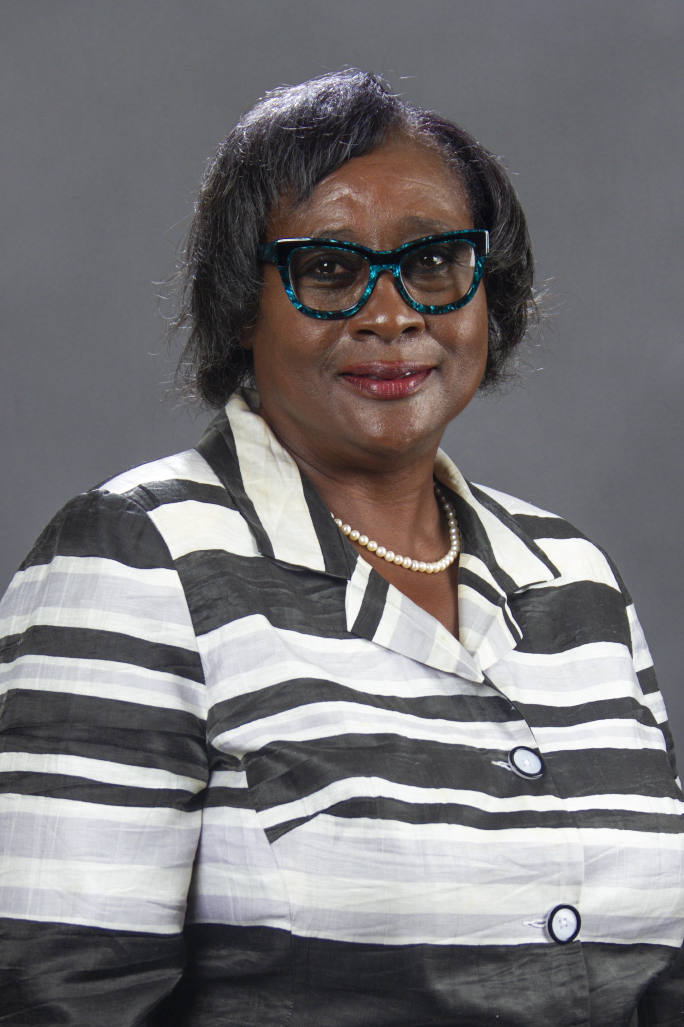
Expand your horizons!
The LeadAR experience was the "change" that allowed me to stretch and discover horizons that I would not have otherwise considered. As a result, I grew personally and professionally and am now a champion for improving the status quo.
Diane Tatum Regional Manager, Entergy (retired) Class 8 - Pine Bluff

