Slide 1
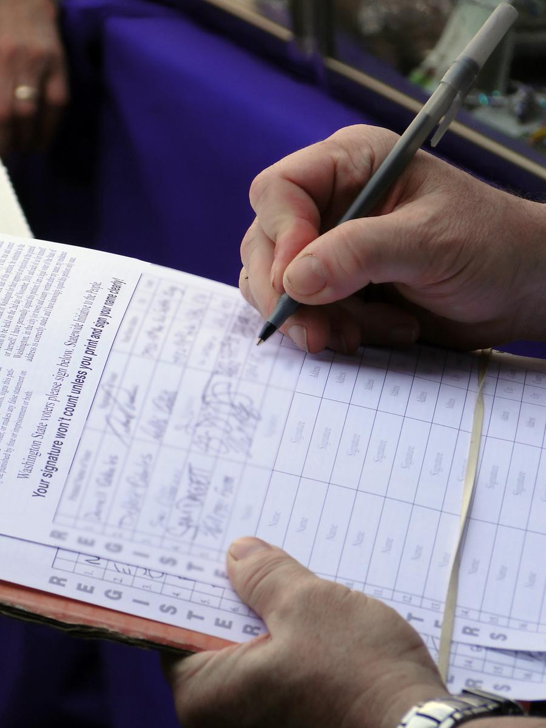
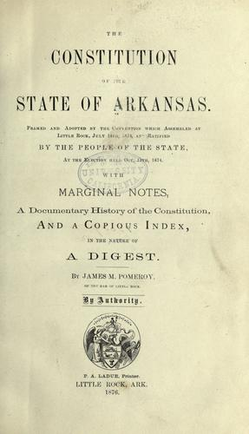
Arkansas Ballot Issues
Date
Your Name
Notes:
Awareness
Knowledge
Informed Decisions
Voting

Slide 2
The Arkansas Constitution
Adopted in 1874
“The people shall be the source of power”
“Thou Shall Not” Constitution
Railroad/levee debt and banking failures
Brooks-Baxter War (End of Reconstruction efforts)
102 Amendments
Voters rejected new constitution in 1970; last efforts in 1990s
Notes:
Arkansas’ Constitution dates back to 1874. Voters have approved 102 amendments since then, but have rejected efforts to pass entirely new or updated state constitutions.
The only way to change the state constitution is through a vote of the people.

Slide 3
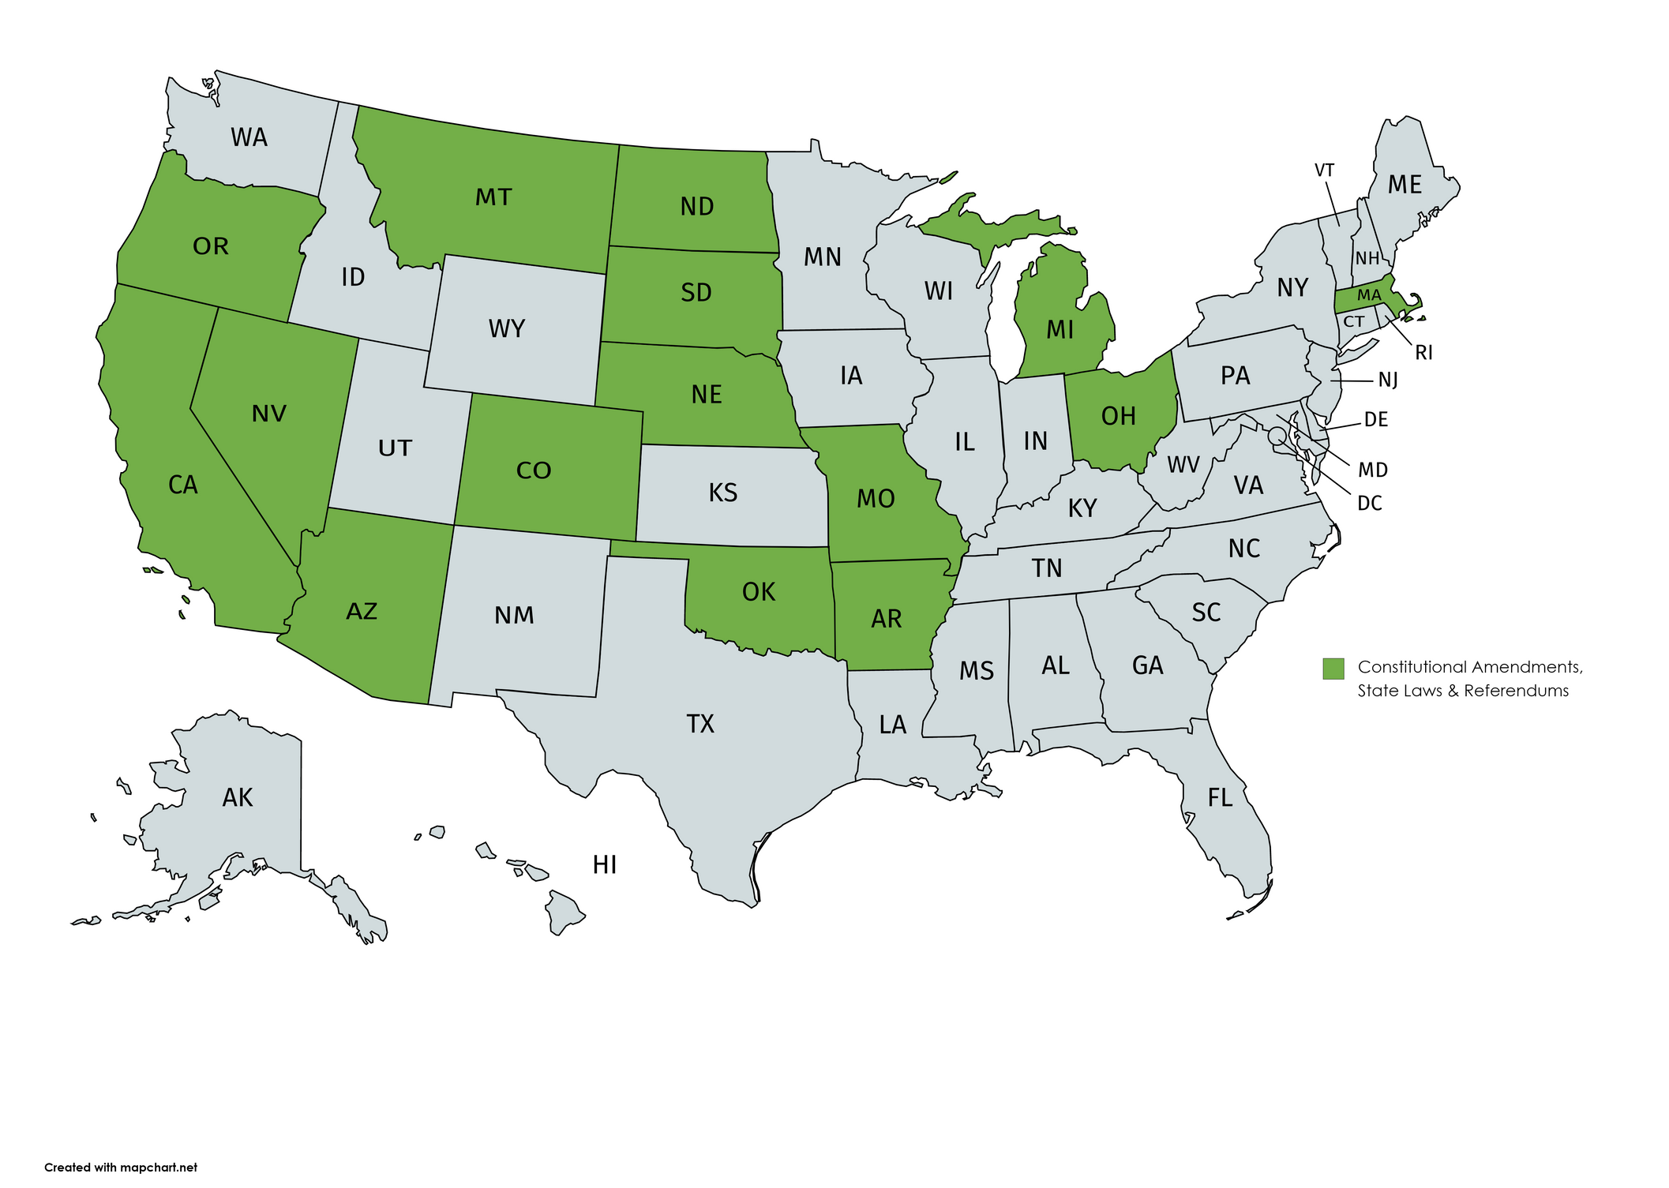
States and Robust Direct Democracy
1 of 15 states where citizens can propose all of these:
amendment
state law
referendum
Notes:
Arkansas is one of 15 states where citizens have the ability to petition and put constitutional amendments, state laws, and veto referendums on the ballot for voters to decide.
We’re the only state in the southeast with this level of direct democracy.
Other states in the U.S. have the citizen initiative process, but ours and 14 other states have a more robust process.

Slide 4
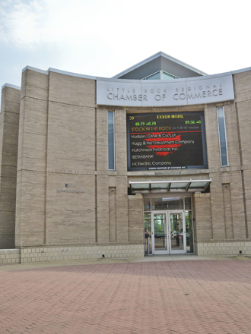
What Are Ballot Issues?
Constitutional amendments
Policy decisions
Adds or removes existing text
Creates new state policy
State laws
Legislature can change in session
Referendums
Limited time frame after session
Notes:
In Arkansas, we may say ballot issue, ballot measure, citizen initiative. These terms refer to the same thing – a proposed policy put on the statewide ballot for voters to decide.
Constitutional amendments change our state constitution. They can add policy, change wording, or remove policy.
Arkansans can also propose state laws, which would be similar to if the legislature proposed and passed a law.
We also have the referendum process in Arkansas, which is when voters decide whether to keep or repeal a new law passed after a legislative session. This isn’t used much in Arkansas but it’s there.

Slide 5
From the Legislature
Proposals filed in odd-numbered years
Constitution allows legislature to refer to voters up to 3 amendments
33 proposals filed in 2023
House & State committees review each issue & vote
Must pass in both chambers
Notes:
Just a refresher – the Arkansas legislature also has the ability to put constitutional amendments on the ballot for voters to decide.
Legislators proposed 33 proposals for the ballot when they met in 2023, but only referred 1 to voters on the 2024 ballot. This is the smallest number of legislative ballot measures in 40 years.
https://www.uaex.uada.edu/business-communities/ced-blog/posts/2023/january/state-lawmakers-start-filing-bills-to-change-arkansas-constitution-in-2024-election.aspx

Slide 6
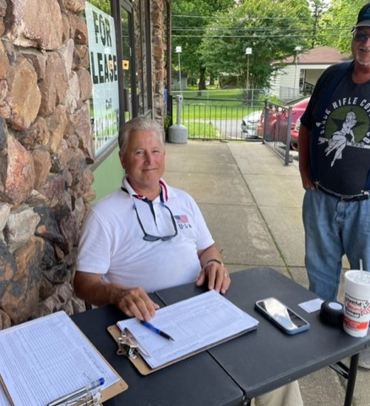
From the Citizens
Can file proposal any time
Attorney General must certify ballot title before collecting voter signatures
Rules for canvassers
Must file with Ethics Commission after spending/raising $500
Required # of signatures to qualify
Notes:
The citizen initiative process in Arkansas is year-round, with ballot issue groups first submitting their ballot titles to the Attorney General’s Office for certification. The AG will reject a ballot title if he finds the wording misleading, incomplete, or full of partisan phrases.
There are a lot of rules for paid canvassers, who after a recent law change must now be Arkansas residents to collect voter signatures.
Citizen-led ballot issue groups must collect a certain number of signatures from voters.

Slide 7
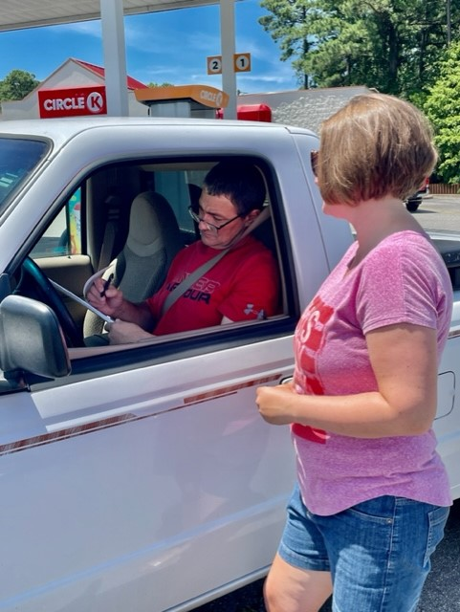
Citizen Ballot Issue Signature Requirements
Statewide
Amendments = 10% (90,704)
State laws = 8% (72,563)
AND
In Those 50 Counties
Signatures equaling 5% of number of people in county who voted for governor
Notes:
For 2024 ballot issues, ballot issue groups needed 90,704 voter signatures from at least 50 of the state’s 75 counties to qualify for the ballot.
In those 50 counties, they must collect signatures equaling 5% of the number of people who voted for governor in that county.

Slide 8
Did you know?
End of the ballot
Popular name & title only
Specific order
Legislative issues go first
Citizen-initiated amendments
Citizen-initiated laws
Notes:
You will find legislative and citizen-initiated ballot measures at the bottom of the ballot.
This year, we have 2 statewide issues for voters to decide. The Arkansas Supreme Court ruled Oct. 21 that votes cast for or against Issue 3, the Medical Marijuana Amendment of 2024, would not be counted. The court found the popular name and ballot title misleading.

Slide 9
2024 Ballot
Notes:
Let me know if you have any questions as we go along.
What’s interesting about this year’s election is all three ballot issues involve a topic that voters approved in the last 15 years.
The three issues on the ballot this year propose changes to those past amendments.

Slide 10
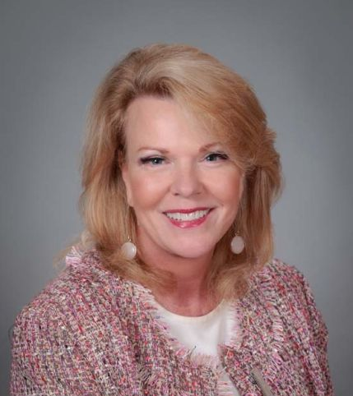
Issue 1 – Lottery Proceeds
Sponsor: Rep. Robin Lundstrum, R - Elm Springs (Benton/Washington counties)
Popular Name
A constitutional amendment to provide that lottery proceeds may be used to fund or provide scholarships and grants to Arkansas citizens enrolled in vocational-technical schools and technical institutes
Ballot Title
An amendment to the Arkansas Constitution to provide that lottery proceeds may be used to fund or provide scholarships and grants to Arkansas citizens enrolled in vocational-technical schools and technical institutes.
Notes:
Issue 1 is a constitutional amendment proposed by the Arkansas legislature.
Rep. Robin Lundstrum of Elm Springs was the main sponsor.
This proposal seeks to expand the types of educational institutions that qualify for state lottery scholarships.
Currently, lottery scholarships can be used at private and public non-profit two and four-year colleges and universities in the state.

Slide 11
Issue 1 – Lottery Proceeds
Summary
Adds public or private vocational-technical school to Amendment 87.
Adds public or private technical institute to Amendment 87.
Notes:
Issue 1 would also allow students to use lottery scholarships at private and public vocational-technical schools and technical institutes.
It’s anticipated the legislature would pass additional laws in future sessions to determine who is eligible to receive the scholarships and grants under this proposal.
Notes:
FY2023: lottery produced a record $114.7 million for scholarships
Since its inception in 2009, ASL has raised more than $1.2 billion in scholarship proceeds.
FY23 was also the second-highest financial year in sales with $607.6 million worth of lottery tickets sold
More than 720,000 college scholarships have been awarded to Arkansans.
The Arkansas Academic Challenge Scholarship provides tuition assistance for Arkansans at two- and four-year public and private colleges.
The Arkansas Workforce Challenge Scholarship is available for students applying for certificate programs in high-demand occupations.
The Arkansas Concurrent Challenge Scholarship provides financial assistance to eligible students in the state who want to take college courses while still in high school.
During the recent legislative session, the legislature created the Arkansas Challenge Plus Scholarship, which provides additional funding for students with an Academic Challenge Scholarship based on their financial needs. Challenge Plus will start accepting students in the fall of 2024.

Slide 12
Issue 2: Repeal Pope County Casino & Require Local Vote
Sponsor: Local Voters in Charge
Popular Name
An amendment requiring local voter approval in a countywide special election for certain new casino licenses and repealing authority to issue a casino license in Pope County, Arkansas
Summary
Removes Pope County (Russellville area) from constitution as an authorized location for a casino license.
Voids the license recently issued for Pope County.
Require countywide election to approve any future casino license.
Notes:
Issue 2 is a citizen-initiated amendment seeking to remove Pope County from the Arkansas Constitution as an authorized location for casino gaming.
Voters in 2018 approved Amendment 100, establishing four authorized casino locations in the state. Those locations included Pope County, Jefferson County, and the race tracks in Hot Springs and Oaklawn.
Issue 2 would only affect the Pope County location, where a casino has not been built yet. The state recently issued the Pope County license to Cherokee Nation Entertainment to operate Legends Casino and Resort. However, construction hasn’t started yet and there’s a federal lawsuit over the license.
In addition to eliminating the Pope County casino license, Issue 2 would also require countywide elections in the event there are ever any future casino licenses approved by voters statewide. The amendment would require local voter approval of any future locations. (Note: this would be triggered only if there’s a future constitutional amendment with new licenses approved in a statewide vote).

Slide 13
Issue 2: Repeal Pope County Casino & Require Local Vote
Sponsor: Local Voters in Charge
Answers to Frequently Asked Questions:
If passed, there will be only the 3 existing casinos in Arkansas
A future constitutional amendment would be required to pass allowing more casinos to allow local communities to vote.
The Pope County location was chosen in 2018 for its distance from other casino locations.
Notes:
Issue 2 is a citizen-initiated amendment seeking to remove Pope County from the Arkansas Constitution as an authorized location for casino gaming.
Voters in 2018 approved Amendment 100, establishing four authorized casino locations in the state. Those locations included Pope County, Jefferson County, and the race tracks in Hot Springs and Oaklawn.
Issue 2 would only affect the Pope County location, where a casino has not been built yet. The state recently issued the Pope County license to Cherokee Nation Entertainment to operate Legends Casino and Resort. However, construction hasn’t started yet and there’s a federal lawsuit over the license.
In addition to eliminating the Pope County casino license, Issue 2 would also require countywide elections in the event there are ever any future casino licenses approved by voters statewide. The amendment would require local voter approval of any future locations. (Note: this would be triggered only if there’s a future constitutional amendment with new licenses approved in a statewide vote).

Slide 14
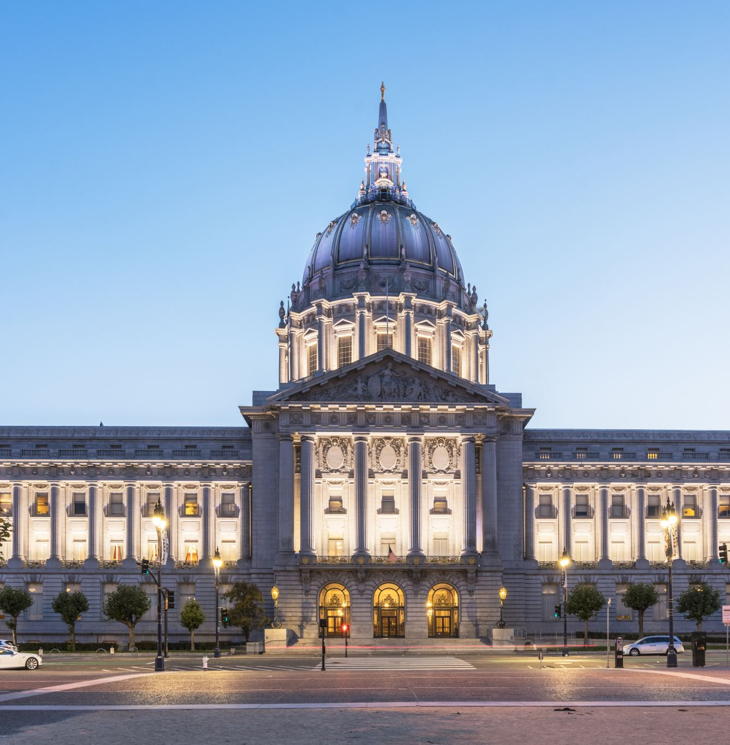
Important Dates
Absentee voting underway
Nov. 5 – Election Day
Notes:
Important dates

Slide 15
Evaluation
Notes:
Scan the QR code to fill out our evaluation about today’s event. Please share with us who we reached and whether you learned anything today.

Slide 16
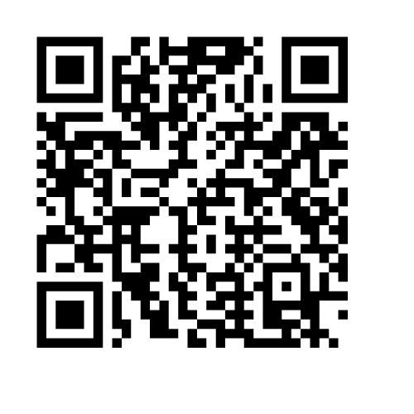
Follow Us
Newsletter
Uaex.uada.edu/ballot
facebook.com/uappc
twitter.com/uaex_ppc
instagram.com/uaex_cped/
Notes:
Scan the QR code to sign up for our newsletter.

