Slide 1

P-card Cardholder Training
University of Arkansas Division of Agriculture
Office of Procurement
Notes:
Welcome to PCard Cardholder Training. The eProcurement Office is under Business Services and administers the PCard Program.

Slide 2
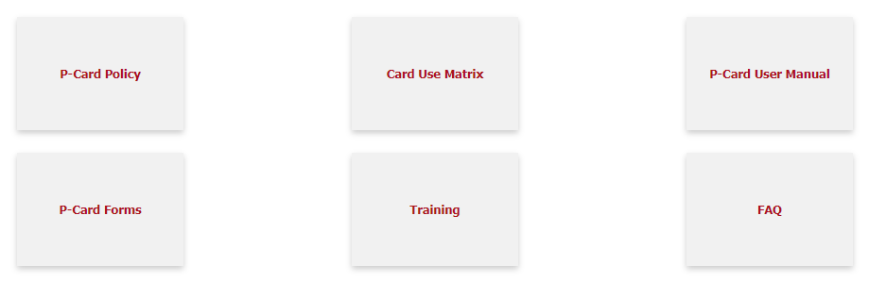
PCard Website: UADA.EDU/PCARD
Located here:
  Bank Contact Information
  PCard Cutoff Dates for FY
  Card Use Matrix (allowable list)
  FAQs & User Manual
  Forms – Business Justification Form, Membership Justification Form, Lost/Unobtainable receipt, etc.
  Training Registration
Notes:
The PCard website, pcard.uark.edu, houses tons of information about the PCard. Policy and Procedures, Cutoff Dates, Training Dates, Gift Card information and so much more can be found here. If you cannot find what you are looking for please contact the eProcurement Office.

Slide 3
Procurement Card (P-Card) Program
Your P-Card is a credit card issued by the University of Arkansas through US Bank to be used for official business purchases
Activate your card by calling
800-344-5696
  Enter Card-#, Billing Zip Code, Last-4 of Workday Employee ID-#
When you activate your PCard you will set up your PIN number
You can register/activate your card online at: access.usbank.com
UADA Policy 390.1: Purchase Card Policy
Notes:
The Procurement Card (PCard) is a credit card issued by the University of Arkansas through US Bank to be used for official business purchases. To activate your PCard you will call the 1-800 number and enter the following information as requested: card number, zip code, last 4 of the SSN, work phone number. Please note that if your work number does not work, you will need to use the Business Services front office number 479-575-2551. When you call to activate your PCard you will set up a PIN number.

Slide 4
Spending Limits
The standard monthly limit is $5,000.
  If you do not spend your monthly limit, money does NOT “roll over” to the next month
The standard single transaction limit is $2,500 (including shipping cost and taxes) – single items over $2500. This is due to capitalization on certain assets.
If you “split” a PCard purchase of an item that needs to be tagged for inventory purposes (items of $2500), you will receive a written warning. If it happens again your card will be suspended.
You may need to make a purchase over your limits. You MUST contact the eProcurement Administrator for approval.
  Include what you need to purchase, why you cannot use a PO and give the final purchase amount including tax and/or shipping.
Your spending limits could be less, depending on your department
UADA policy 390.1.3. A & B
Notes:
The standard monthly spending limit is $5000. If you do not spend your monthly limit money does not roll over to the next month. The standard single transaction limit is $2500. This limit is due to the capitalization of assets for tracking.
If you purchase an item over $2500 by splitting the cost you will receive a written warning, if it happens again your card will be suspended. There is never a reason to split a purchase, if you need to make a purchase over your limits you must contact the eProcurement Administrator for approval. Include what you need to purchase, why you cannot use a PO, and give the final purchase amount including taxes and shipping.
Your spending limits may be less depending on your department.

Slide 5
Billing/Spending Cycles
15th through the following 14th
Your monthly spending limit resets every 30 days.
The Billing Cycle resets on the 16th day of each month, unless it falls on a Sunday.
Notes:
Your monthly spending limits reset every 30 days. The Billing Cycle resets on the 16th of each month, unless it falls on a Sunday.

Slide 6
Authorized Uses
UADA Policy 390.1.1
UADA p-cards may only be used for authorized business purchases that are not specifically prohibited by State of Arkansas and/or UADA Guidelines.
Personal charges are strictly forbidden. Cardholders are not permitted to use a UADA p-card for personal expenses, even if the cardholder intends to reimburse UADA for the personal charges | The cardholder will be required to reimburse UADA for any unauthorized charges or personal charges. Repeated personal charges to a UADA p-card may result in suspension or revocation of p-card privileges.
Notes:
The Procurement Card (PCard) is a credit card issued by the University of Arkansas through US Bank to be used for official business purchases. To activate your PCard you will call the 1-800 number and enter the following information as requested: card number, zip code, last 4 of the SSN, work phone number. Please note that if your work number does not work, you will need to use the Business Services front office number 479-575-2551. When you call to activate your PCard you will set up a PIN number.

Slide 7
Items NEVER allowed to be purchased with the P-Card
Personal Items
Items for Personal Use
Birthday/Holiday/Greeting/Thank You Cards
Supplies and food that is used for office birthday parties or celebrations
Personal Convenience Items (candy, coffee, coffee makers, microwaves, etc.)
Gifts of any kind (including sponsorships, flowers)
Travel Expenses
Airfare or other travel expenses such as lodging, car rental, fuel, etc.
Conference/Meeting Registrations that involve a travel component
Contracted Services
Any purchase that requires an official University signature such as: maintenance agreement, software license agreement, contract, etc.
Construction or Remodeling
Restricted by State Mandate
Mandatory State Contract Items:
Paper Towels, Tires
Printing using a printing press (wet ink on paper via a printing press)
Alcoholic Beverages
Narcotics/Prescriptions/Over the Counter Medicine used for human consumption
Additional guidance: reference “Card Use Matrix” on P-card webpage: WWW.UADA.EDU/PCARD
Notes:
There are some items that are NEVER allowed to be purchased with a PCard. Those items include: alcoholic beverages, birthday/holiday/greeting/thank you cards, supplies and food for office birthday parties or celebrations, items for personal use, personal convenience items such as candy, coffee, coffee makers, etc., printing using a printing press, any purchase that requires an official university of Arkansas signature such as a maintenance agreement, airfare or other travel expenses such as lodging, car rental, fuel, narcotics/prescriptions/over the counter medicine used for human consumption, construction or remodeling, gifts of any kind including flowers. If you ever have any question if an item is allowed, please call the eProcurement Office before making the purchase.

Slide 8
Official Billing Address
When you need to use a billing address for a purchase, use the following address as it appears below.
  Your Name (Name on Card)
  2301 S. University Ave
  Little Rock, AR 72204
  NOTE: DO NOT ship to this address
ALWAYS ship items purchased with a PCard to an official University of Arkansas address.
  2301 S University Ave
  Little Rock, AR 72204
Notes:
When making online purchases the billing address that you will use is the address to the administration building. 1125 West Maple Street ADMN 321 Fayetteville, AR 72701. All of the words must be spelled out completely. Remember DO NOT ship to this address, this is only a billing address not a shipping address.
Always ship items to an official University of Arkansas address, never ship to a personal address.

Slide 9
P-Card Delegation
Policy 390.1.5
In limited and infrequent circumstances, it may be appropriate for cardholders to delegate use of a p-card.
  The delegate must complete p-card training.
  The cardholder and delegate must complete an Acknowledgement of Delegation form.
  The cardholder must document all instances when someone else uses their p-card by completing the P-Card Transaction Log.
  Limits on delegation:
  7-consecutive days per delegation; 3-consecutive delegation terms;
  30-days total per calendar year.
  Cardholder is responsible for all card activity on their card.
Notes:
When making online purchases the billing address that you will use is the address to the administration building. 1125 West Maple Street ADMN 321 Fayetteville, AR 72701. All of the words must be spelled out completely. Remember DO NOT ship to this address, this is only a billing address not a shipping address.
Always ship items to an official University of Arkansas address, never ship to a personal address.

Slide 10
More about the PCard
If you receive ANY promotional gift card, coupons, rebates, or items while making online OR in store purchases, remember that these items belong to the University of Arkansas and are NOT yours to take home.
  You may accept these items as long as you turn them in to your department for further University business use.
Do NOT receive cash back on any purchase, return, or exchange of items purchased on the PCard
Call the Bank BEFORE calling the PCard Office.
If your PCard is ever lost or stolen, call US Bank Customer Service at: 800-344-5696
If you suspect fraud on your PCard, call US Bank Fraud Department at: 800-344-5696
Notes:
If your PCard is ever lost or stolen, call US Bank Customer Service. If you suspect fraud on your PCard call US Bank Fraud Department. Call the Bank BEFORE calling the PCard Office.
At anytime, you can check Workday for your PCard charges. To do this, simploy log into Workday. Go to the search field on your home screen, type in “Verify Procurement Card Transactions”, press Enter, and then click on “OK”. You have the ability to call US Bank Customer Service and check your current balance whenever you desire.
If you receive ANY promotional gift card, coupons, rebates, or items while making online OR in store purchases, remember that these items belong to the University of Arkansas and are NOT yours to take home. You may accept these items as long as you turn them in to your department for further University business use.
Do NOT receive cash back on any purchase, return, or exchange of items purchased on the PCard.

Slide 11
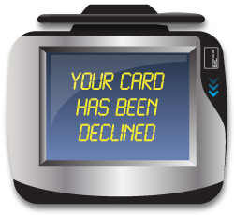
What if your PCard is declined?
There are 5 reasons your PCard may be declined:
  You did not use the correct billing address
  You have exceeded your single transaction limit of $2,500.
  You have exceeded your monthly limit of $5,000.
  The Bank has blocked the charge for Fraud; or an incorrect PIN was input.
  You attempted to use your card and the merchant category code is blocked.
    MCCs can be added to a card profile as needed.
If your card is declined please contact the Procurement office within 48 hours of attempting your purchase.
Notes:
There are 5 reasons your PCard can be declined.
The first happens when online shopping, make sure you are using the correct billing address then try again.
Second, you have exceeded the single transaction limit of $2500. Remember never split a purchase to make it under the single transaction limit.
Third, you have exceeded your monthly limit of $5000.
Forth, you have attempted to use your card and the merchant category code is blocked.
And fifth, the bank thinks the charge is fraud and blocked it.
If your card is ever declined please contact the eProcurement Office within 48 hours. Many times the eProcurement Office can fix the error quickly so you can continue your purchasing.

Slide 12
Online Purchases: Amazon and PayPal
If PCards are used to purchase from Amazon or through PayPal, you are required to set up a separate account specifically for University business ONLY
  This account will need to be tied to your University email and only used for official business only.
  Business is Business – Personal is Personal
UADA participates in the state-level Amazon Business Prime Membership; individual memberships are free.
  Contact: purchasing@uada.edu
Notes:
You may use PCards to order from Amazon and PayPal. However, you must set up a separate account that is tied to your University of Arkansas email address. You want to keep business, business and personal, personal. Departments are allowed to purchase an Amazon Prime Membership, but it is up to each department. The eProcurement Office recommends only one membership per department.

Slide 13
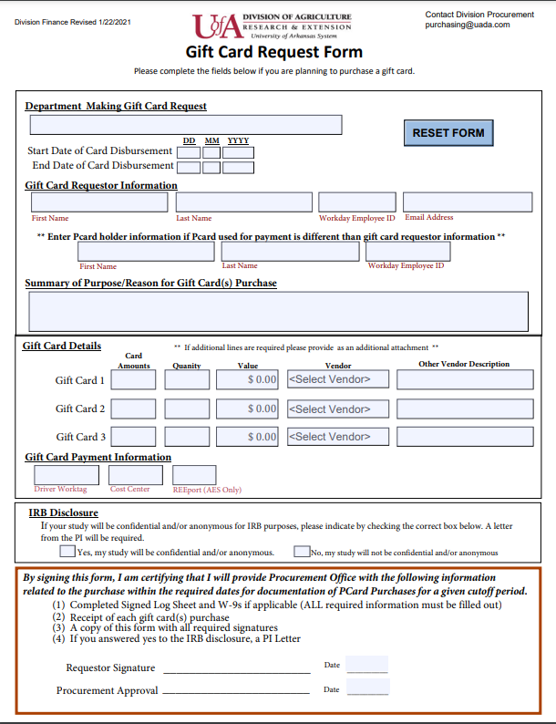
Gift Cards & Prizes with a PCard
If your department needs to purchase Gift Cards or a Prize with a PCard the Gift Card Purchases using PCard webpage needs to be read in its entirety.
You MUST receive pre-approval from the Procurement Office to make these purchases.
  If you do not get pre-approval your card will be immediately suspended.
Gift Cards can only be purchased from Walmart, SAMs Club, or Amazon, when using P-card.
The signed approval form and a disbursement log needs to be turned in with the receipt.
Notes:
Gift Cards and Prizes may be bought with a PCard if you receive PRIOR approval from the eProcurement Office. Read the entire Gift Card Purchasing using a PCard page before beginning. Prior approval is required before making these purchases. If prior approval is not obtained your PCard will be immediately suspended. Only gift cards from Walmart, SAMs, or Amazon are allowed on the PCard. The signed approval and disbursement log will need to be turned in with the receipt.

Slide 14
Responsibilities of Holding a PCard
Keep your PCard and account number CONFIDENTIAL.
Use your PCard for official University business ONLY and understand the non-allowable list
For each charge to a UADA p-card, the cardholder is responsible for acquiring adequate documentation of the charge and supplying the documentation to support the purchase of goods or services for which the p-card was used
Upon termination of employment or if a PCard is no longer needed, ask your department to cancel your card.
Report a lost or stolen PCard immediately to US Bank at 800-344-5696
Notes:
Responsibilities of owning a PCard include keeping the account number confidential, using the PCard for official business only, keeping up with receipts and submitting them on time complete with any additional documentation that is required. Read the listserv messages. Upon termination of employment or if a PCard is no longer needed, as your department to cancel your card. Remember to report a lost or stolen PCard immediately to the US Bank.

Slide 15
Misuse of Your PCard
*P-card policy: V, a. 1-3
1st Offense
Written warning regarding p-card use from UADA Business Office.
2nd Offense
Written warning regarding p-card use from UADA Business Office and suspension of cardholder privileges for a minimum of 60 days; or up to 120 days
3rd Offense
Cardholder’s privileges revoked and p-card canceled.
After 180 days, the supervisor may submit written justification for a new p-card to be issued.
The cardholder’s supervisor must justify reinstatement of the cardholder’s privileges in writing.
Requires approval by Assoc VP for Finance and Administration
Cardholders will be required to complete additional training before privileges may be reinstated.
Understand that intentional misuse or abuse of the PCard or PCard rules will result in immediate revocation of PCard privileges and possible disciplinary and legal action
If we suspect you are using your card fraudulently or inappropriately, your card will be suspended, you and your approver will be notified, internal audit will be notified, possible investigation and termination of employment.
The eProcurement Office reserves the right to suspend/cancel cards immediately depending on the severity of the offense
If you are invoiced for a personal/non-allowable charge, reimbursement to the organization will be required. *p-card policy: I. C.
Notes:
The misuse of your PCard. For the first Offense of an unverified charge, or non-allowable purchase on your PCard, you will receive a written warning from Business Services, and you will be offered more training. For a second offense of an unverified, or non-allowable purchase, you will temporarily loose your PCard privileges and must attend training again. For habitual offenses of unverified, or non-allowable purchases, your card will be suspended indefinitely. You and your PCard approver will be notified. If you want to reinstate your privileges, you must contact the eProcurement Administrator.
Understand that intentional misuse or abuse of the PCard or PCard rules will result in immediate revocation of the PCard privileges and possible disciplinary and legal action.
If we suspect you are using your card fraudulently or inappropriately, your card will be suspended, you and your approver will be notified, possible investigation and termination of employment.
The eProcurement Office reserves the right to suspend/cancel cards immediately depending on the severity of the offense.
If you are invoiced for personal/non-allowable charge your Department’s Budget Officer will be copied on the invoice.

Slide 16
Verify Procurement Card Transactions
The Verification process in Workday is the required method for assigning accounting to P-Card transactions.
Documentation Requirements:
Each Verification Requires:
Accounting Sequence: Spend Category, Cost Center, Driver Worktag
Attachments: Itemized Receipt, Supporting Documentation (Official Function Form, or similar)
No more than 5-10 transactions per verification, to avoid approver overload.
Tax Details: Select whether tax was collected; and whether tax should be remitted to the state.
Multiple transactions may be verified in a single verification document.
Transactions are assigned to a verification document using process: Verify Procurement Card Transactions
The documentation must be merchant produced
The documentation must include details relevant to the purchase such as date, description, quantities, amounts, the total charge amount, and the merchant’s name/address.
If a receipt is lost and cannot be replaced, please submit an Affidavit of Lost Receipt
Notes:
Cardholders should get in the habit of submitting their receipts to their PCard Approver or department Administrator at a minimum of once per week. Cardholders must have all receipts to their approver by the Cutoff Date.
Each department has a PCard Approver: This is who you submit receipts to, then your department’s approver will submit them to the eProcurement Team via Workday. All receipts are now due at the time of verification.
Every PCard purchase requires and itemized detailed receipt to be reviewed for validity and approval. If you make a purchase and lose the receipt: first contact the vendor and request a duplicate receipt. If one cannot be obtained, then you must submit a Lost or Unobtainable Receipt form – this form should be used as a last resort. Some purchases made with a PCard require additional documentation, which must be submitted together with the receipt. You can find forms and other information on the PCard website.

Slide 17
Transaction and Verification Apps
At anytime, you can check Workday for your P-Card charges:
  To do this, simply log into Workday. Go to the search field on your home screen, type in “My Transactions”
  Verify (Verify Procurement Card Transactions)
    Assign transactions to a verification
  My Transactions (My Procurement Card Transactions)
    View card transactions tied to your name
  My Verifications (My Procurement Card Transaction Verifications)
    View verifications tied to your name
Notes:
Understanding PCard dates is important to being a compliant cardholder. The Begin Date is the billing cycle start date. The Cutoff Date is the date cardholders should have all their receipts turned in to their Approvers. The Verifications Due Date is the date all charges uploaded by the cutoff date must be verified in Workday. We recommend that cardholders get in the habit of turning in receipts and verifying all their outstanding transactions weekly.

Slide 18

PCard Audit Process
The Business Office audits ALL PCard purchases as they are verified in Workday.
Verifications requiring correction will be Sent Back in Workday
Sent-back verifications will return to Draft status for correction. (Use: My Verifications to view Draft status verifications)
Transaction accounting will post after the verification is fully approved.
Notes:
PCard purchases are audited by the eProcurement Office. Audits include: Walmart, SAMs, Amazon, Restaurants, Level 3, Random, Cardholders who are Approvers, Purchases over $2500 and Lost or Unobtainable Receipts. If the eProcurement Office has questions about a purchase, the verification in Workday will be returned requesting more information. This process is designed to keep the Institution in compliance with all laws and policies.

Slide 19
Verification Due Dates
All PCard charges must be verified in Workday by the Verifications Due Date – The 5th Working Day of each month
We encourage Cardholders to turn in receipts & verify their outstanding charges weekly.
If charges are not verified by the Verifications Due Date, the card will be suspended, pending completion of outstanding verifications and notification of completion to pcard@uada.edu.
Unverified charges older than 30 days will have their card suspended an additional 30 days.
Unverified charges after 60 days will result in revocation of p-card privileges; the card will be cancelled.
Workday automatically notifies cardholders & supervisors if a transaction is left for 2 weeks without any action being taken.
*P-card policy: V, b: 1-3
Transaction Month | Verification Due Date
Jan | Feb 7, 2025
Feb | Mar 7, 2025
Mar | April 7, 2025
April | May 7, 2025
May | June 6, 2025
June | July 9, 2025 *subject to change, due to holidays/fiscal deadlines
Any variation in this schedule will be communicated by email.
Notes:
All PCard charges must be verified in Workday by the Verifications Due Date. We encourage all Cardholders to turn in receipts & verify their outstanding charges weekly. If charges are not approved by the Verifications Due Date, Cardholders will receive a warning. If it continues the card will be suspended. This process is outlined under Misuse of Your PCard.

Slide 20

Congratulations you are ready to use your PCard!
I will email a Certificate of Completion & Cardholder agreement form to you
Attach certificate to questionnaire in Workday
If you ever need any assistance, you can contact the eProcurement Team:
  pcard@uada.edu
  479-502-9701
Notes:
Congratulations! You can now come pick up your PCard and sign the PCard Agreement form in ADMN 321.
If you need to contact the eProcurement Office please email pcard@uark.edu or call 479-575-2551.
Thanks for watching!

